Slide 1
New Brunswick Sentinel Practitioners Influenza Network NB SPIN
November 2020

Slide 2
Public Health New Brunswick
Influenza Program and Surveillance
Suzanne Savoie , CD Surveillance Officer, NB SPIN Coordinator
Shelley Landsburg, Director of Disease Prevention and Control
Rita Gad, Director of Epidemiology and Surveillance and Senior Epidemiologist
Janice Jardine , Senior Program Advisor Respiratory Diseases
Louis-Alexandre Jalbert, Laboratory Technical Liaison Officer
Medical Officers of Health
Dr. Cristin Muecke, Deputy Chief Medical Officer of Health
Dr. Yves Leger
Dr. Kimberley Barker
Dr. Mariane Pâquet
Dr Na-Koshie Lamptey
Senior Management:
Heidi Liston, ADM for Public Health New Brunswick
Eric Levesque, ED for Public Health New Brunswick

Slide 3
Overview
Principles of surveillance
Collaborations
Distribution of NB SPIN sites
Procedures

Slide 4
Principles of Surveillance
Epidemiologic surveillance is the ongoing systematic collection, recording, analysis, interpretation, and dissemination of data reflecting the current health status of a community or population
Types of surveillance: passive, active, enhanced, syndromic
Traditional sources of surveillance data: clinical reports, laboratory testing and results

Slide 5
Principles of Surveillance
Sources of surveillance data: sentinel practitioners (clinical and laboratory), influenza-associated hospitalizations and deaths, influenza and ILI outbreak reporting (nursing homes, hospitals, schools, workplaces and other settings), media reports monitoring
There is no single perfect source of surveillance data: different types/sources usually complement each other

Slide 6
Principles of Surveillance
What are desired characteristics of a surveillance system?
Ownership of the system by stakeholders
Well described and understood processes of data flow
Completeness of data
Timeliness of data submission, collection, analyses and dissemination
Acceptable, flexible
Strong technical characteristics of data
Representative
Simple, stable

Slide 7
Principles of Surveillance
How to enhance the value of surveillance system?
Maintain consistency and regularity in reporting
Build a “longer” baseline (statistics always work better with larger numbers)
Feedback and dissemination are as important as reporting

Slide 8
Principles of Surveillance
Which condition(s) should be placed under surveillance?
Common and rare
Associated with significant mortality/morbidity
Required by Public Health laws, national or international authorities
Generate media publicity
Emerging diseases and syndromes
Usually intervention or action (immediate or delayed) is available

Slide 9
Principles of Surveillance
Surveillance versus Research
Both can use the same scientific methods
Research usually tests hypothesis while surveillance frequently generates it
Dissemination is regular with surveillance versus one-off with research
Surveillance activities often fall under Public Health laws

Slide 10
Principles of Surveillance
Good surveillance system should be evaluated
Several guidelines and frameworks to evaluate surveillance systems are published
(e.g.) MMWR Recommendations and Reports Updated Guidelines for Evaluating Public Health Surveillance Systems. Recommendations from the Guidelines Working Group July 27, 2001 /50(RR13);1-35

Slide 11
Principles of Surveillance
Scale of surveillance
International
National
Provincial
Local
Scale is selected based on the condition, relevant laws and regulations, number of contributors

Slide 12
Reasons for the effective surveillance of influenza
Very common disease
Routine notifications are incomplete
Vaccine efficacy is not 100% but has a major impact on severity of disease
Improve and encourage testing to detect circulating strains
To detect early indications of changes in disease epidemiology
Potentially be an early warning system e.g. H7N9, H1N1, H5N1, other novel viruses
Monitor health seeking behavior

Slide 13
NB Influenza Surveillance System
Several sources of data:
Laboratory data from the DGLDHUC influenza reference laboratory and the National Microbiology Laboratory.
Reports of outbreaks of influenza and influenza-like illness from nursing homes, hospitals, schools and other settings.
National CIRN-SOS, a hospital-based surveillance of influenza hospitalizations or deaths in adults.
Influenza-associated Hospitalizations and Deaths surveillance data.
Epidemiological data obtained from NB sentinel network of clinicians and ER sites.

Slide 14
Role of NB SPIN in influenza surveillance activities
Lab system
NB SPIN
Influenza
outbreaks
(nursing home,
hospitals, other)
ILI outbreaks
(schools)
Hospitalization
& Death
Monitor
daily
lab
extracts
Weekly
spec,
non-ER
also ILI
Reg. report
to
Regional
PH
Reg. report
to
Regional
PH
Monitoring
of severity/
outcome
related to
influenza
Prov/Regional
Action, analysis,
report
Regular
analysis,
report
Regional action,
regular analysis
& report
Regional action,
Regular analysis
& report
Prov/Regional
Action, analysis,
report
Monitor, detect new strains, describe NB influenza epidemiology &
provide intelligence for informed decision making
Prevent, mitigate, decrease influenza related
morbidity & mortality in NB

Slide 15
Cumulative numbers of positive influenza specimens by subtype and age groups, Canada, 2019-2020, up to August 22 2020
Reference: Figure taken from national Fluwatch report week 30-34 (to August 22 2020)

Slide 16
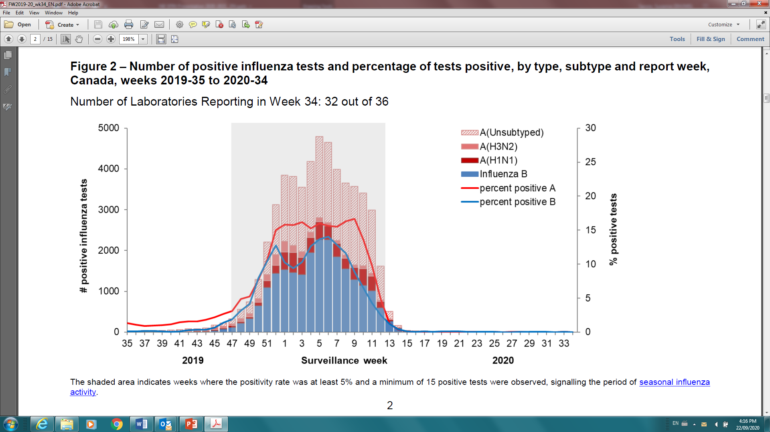
Influenza tests reported and percentage of tests positive, Canada, by report week, 2019-2020, up to August 22 2020
Reference: Figure taken from national Fluwatch report week 30-34 (to August 22 2020)

Slide 17
Number and percent of positive influenza specimens in New Brunswick (based on data from GDHUC Laboratory), by week, up to August 22 2020
Reference: Figure taken from New Brunswick weekly influenza report week 30-34 (to August 22, 2020)

Slide 18
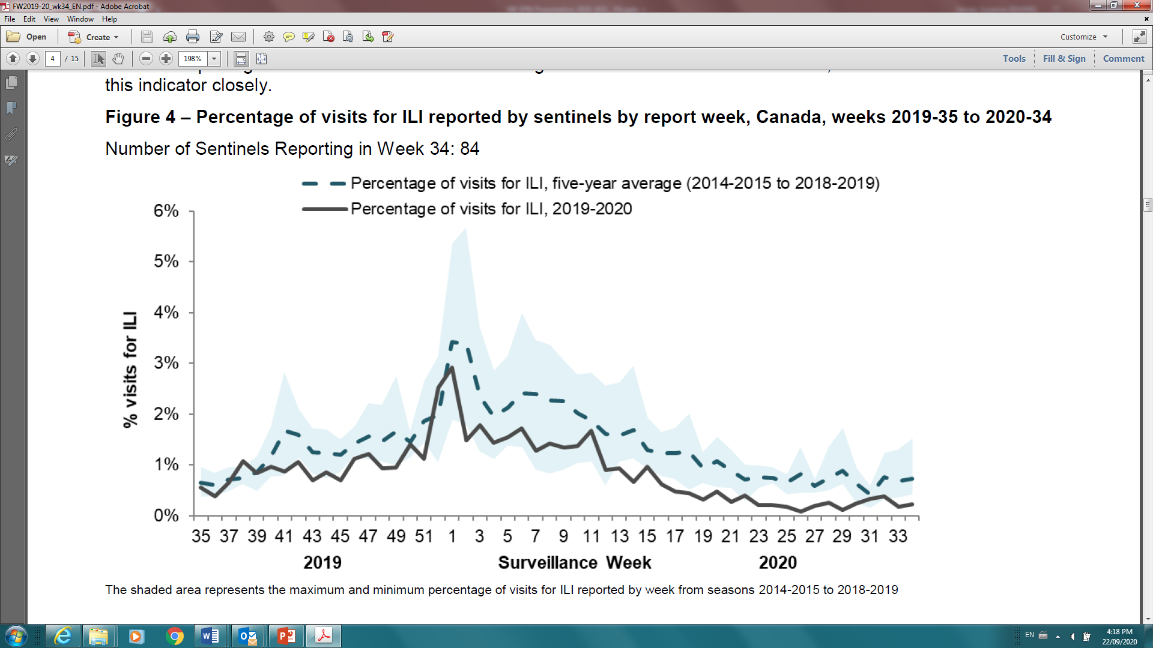
Percentage of Influenza-like illness (ILI) visits reported by Sentinels, by report week, Canada, 2019-2020.
Reference: Figure taken from national Fluwatch report week 30-34 (to August 22 2020)

Slide 19
NB SPIN collaboration
Collaboration between a number of key organizations:
Public Health New Brunswick
Regional Medical Officers of Health
Department of Health; Hospital Services
Regional Health Authorities
Dr. Georges-L.-Dumont University Hospital Centre Laboratory, Moncton
FluWatch, Public Health Agency of Canada
Clinicians( NB Physicians, Nurses and Nurse Practitioners)
First Nation communities
University of NB and Universite de Moncton

Slide 20
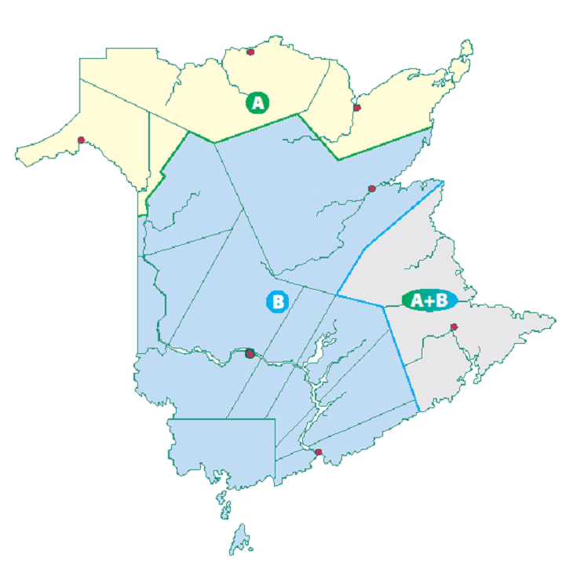
NB SPIN Sentinel Sites
Campbellton x 1
Edmundston x 1
Bathurst x 1
St. Anne de Madawaska x 1
Miramichi x 1
Elsipogtog First Nations x 1
Doaktown x 1
Tobique First Nations x 1
Shediac x 1
Woodstock x 1
Fredericton x 3
Moncton x 3
Sussex x 1
Sackville x 1
Riverside Albert x1
Saint John x 3

Slide 21
NB SPIN site types (ILI Consultations and Specimen Collection)
Physician Offices = 2
ER=8 sites
Community Health Centers =7
First Nation Health Clinics = 2
University Student Clinics = 2
Nursing Home = 1

Slide 22
Procedure: during each week

Slide 23
Procedure: during each week
ONLY non-ER sites are asked to contribute to ILI component
ALL types of sites are asked to contribute to the lab component, although there may be a few exceptions.
The site representatives are asked to contact the NB SPIN Coordinator if there are any problems, or if the representative determines that their site would not reliably contribute to either the ILI or lab component.

Slide 24
Recording ILI

Slide 25
ILI Definition
Acute onset of respiratory illness with fever and cough and with one or more of the following:
Sore throat
Arthralgia
Myalgia or prostration
which could be due to the influenza virus
In children under 5 GI symptoms may be present
In patients under 5 or 65 and older, fever may not be prominent

Slide 26
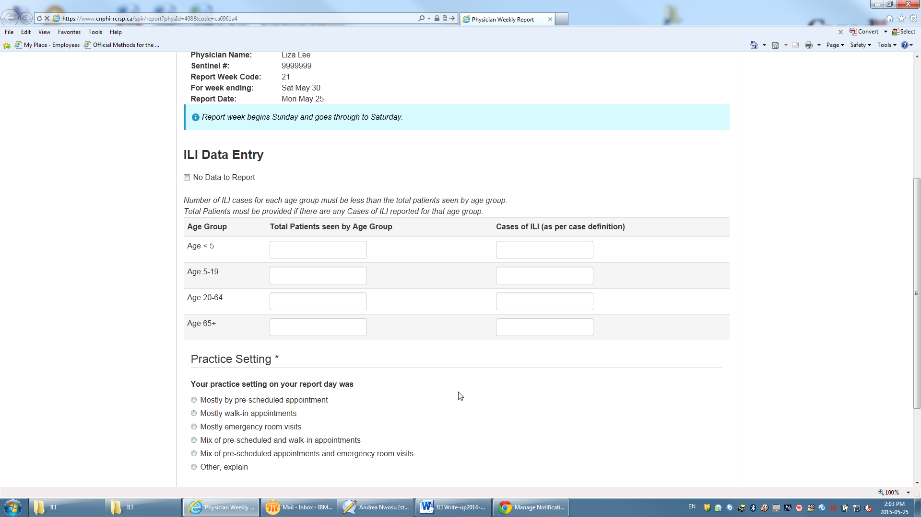
ILI Data Entry Screen

Slide 27
Testing Processes
Testing processes are not relevant for the 2020-2021 season due to the suspension of the swab collection component of the program.

Slide 28
Thank you!

