Slide 1




Everyone at Their Best
CHOOSING A PROGRAM TO LEARN FRENCH
In New Brunswick, students have the following options to learn French within the public school system
Notes:
Welcome to this presentation on New Brunswick French second language programs. No matter where you live, your child will learn French as part of the curriculum. Although this presentation outlines all programs, your school administration will communicate how French Second Language is taught in your school. Thank you for taking the time to review this short information session to learn more about French Second Language as part of your child’s education.

Slide 2

French Second Language Programs for 2022-23
All schools offer English Prime with the Intensive French Program
  K to Grade 3: Learning Experiences/FLORA
  Grade 4: FLORA/Pre-Intensive French
  Grade 5: Intensive French
  Grades 6 to 12: Post-Intensive French
Many schools offer a French Immersion Program
  Grade 1 (Early entry)
  Grade 6 (Late entry)
Notes:
There are multiple French programs in New Brunswick:
Pre-intensive, Intensive and Post-Intensive French are offered in all schools for English Prime students. As well, all students in the primary grades participate in French language and cultural learning experiences to support positive attitudes and introduce some simple French vocabulary. In some schools, elementary students may be learning French through FLORA which will be explained later in this presentation.
Where circumstances warrant, students may enter French Immersion in Grade 1 or in Grade 6.
For all programs, French is compulsory until the end of Grade 10. In Grades 11 and 12, there are additional opportunities to build French Language skills.
Each French Second Language program has its own language targets describing how well learners will speak, read and write. Language learning is a lifelong pursuit. Students are provided with opportunities to use the language in various contexts. We will expand on this later in the presentation.

Slide 3
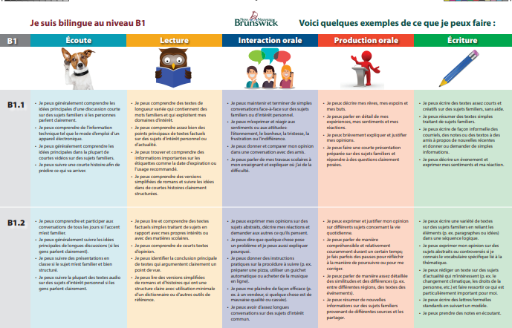


All New Brunswick French Programs are CEFR aligned
CEFR stands for: Common European Framework of Reference
It is an internationally recognized framework for second language
It provides benchmarks for speaking, listening, reading and writing
It highlights the progression of bilingualism
Bilingualism is a life-long journey
English poster may be found at https://bit.ly/3kHLeMs
Notes:
New Brunswick has introduced CEFR-based posters to help learners understand their progress in French.
The proficiency levels are based on the levels described in the CEFR. They are available in English and French.
CEFR stands for: Common European Framework of Reference.
It is an internationally recognized framework for second language.
It provides benchmarks for listening, speaking, interacting, reading, and writing.
It highlights the progression of bilingualism.
Bilingualism is a life-long journey.

Slide 4
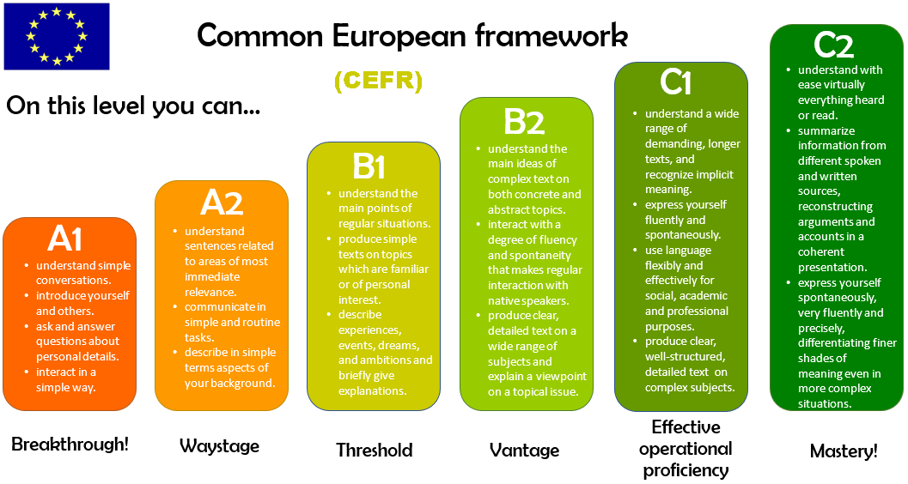
Notes:
The CEFR is divided into 6 levels:
A1 – the learner can communicate basic things with help from the listener
A2 – the learner can communicate in limited situations
B1 – the learner can communicate important ideas in familiar situations
B2 – the learner can use language with some fluency in a range of contexts
C1 – the learner can use language fluently and flexibly in many contexts
C2 – the learner can use language fluently and precisely in most contexts
Often, each of these levels is further subdivided. For instance, A is often subdivided into A1.1 and A1.2 as well as A2.1 and A2.2.

Slide 5

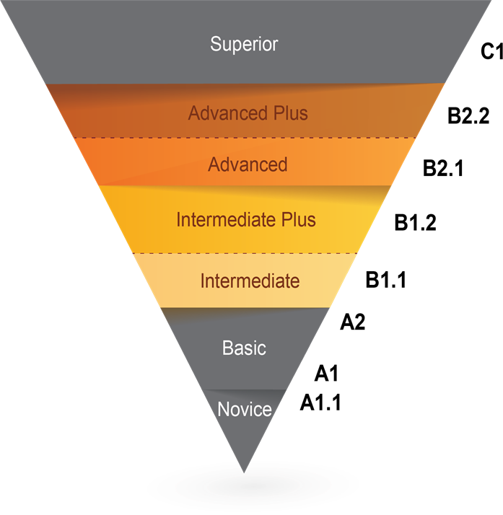



Oral Proficiency Levels
Student proficiency results will depend upon various factors including personality, attitude, motivation, and time spent learning and interacting in French outside the classroom such as summer immersion programs, travel, exchange programs, etc.
Time spent learning and interacting In French will impact the level of proficiency achieved
Notes:
There are Oral Proficiency target levels for each French Second Language program. Student performance will depend upon various factors including personality, attitude, motivation, and time spent learning and interacting in French outside of school such as summer immersion programs, travel, exchange programs, etc.. Not all students will reach the program target while some will exceed it. In order to solidify and improve language complexity, learners will need to read and access other French Language opportunities outside of school.
Please refer to the brochure for more detailed descriptions of the levels of proficiency (OPI and CEFR).
NOTE: Hover the mouse over each audio icon to reveal the audio control bar. Then, click on the play icon to hear examples of what to expect..

Slide 6

Now, let’s take a look at the programs*
ENGLISH PRIME AND FRENCH IMMERSION
*Please note: the prescribed programs in this presentation may not be exactly as described if your school is participating in the Language Learning Opportunities prototypes.
Notes:
Please note: the prescribed programs in this presentation may not be exactly as described if your school is participating in the Language Learning Opportunities prototypes.
Under this prototype initiative, school teams follow an innovation design process to develop programming that best suits their needs. This provides educators the flexibility and decision-making power to design a model for their students with the goal of improving French language learning.

Slide 7

English Prime Program Overview
French language and cultural experiences K−3.
FLORA (French Learning Opportunities for Rural Areas) is now available for K−5 schools.
Most of the day is in English with time for learning French.
French is compulsory in Grades 4−10 and offered as an elective in all schools in Grades 11−12.
Intensive 5-month block typically offered in Grade 5 (occasionally occurs in combined 4/5 classes).
At the end of Grade 5, there are two program options: French as part of the Post-Intensive program or Late French Immersion.
Notes:
For all students in the English Prime Program, French instruction starts in Grade 4. In Grade 5, students learn French in an intensive 5-month block.
Prior to French instruction starting in Grade 4: Learning experiences that introduce French language and culture or the FLORA program create excitement for learning French for learners in K – 3.
The FLORA program, which has been piloted in 13 schools, is now available to all elementary schools. Its flexibility allows it to be used by teachers, in centers, in groups on-line, or individually.
French language learning is compulsory from Grades 4-10 and French courses are offered in all schools in Grades 11-12.
Intensive is usually offered in Grade 5.
In Grade 6, students may enroll in late immersion where the program is available.

Slide 8


French Second Language (FSL) Programs
FLORA: French Learning Opportunities for Rural Areas
  is a made-in-New Brunswick French program for early language acquisition that includes educational songs, animated characters, readings and activities
  can be accessed from home to support in-class learning and for fun
  uses the same approach as Intensive French where modelling the language is central
  used in some schools in K-3 to introduce French culture and language as well as in grade 4 as a means to prepare for Grade 5 Intensive French
  used in some schools in K-3 to introduce French culture and language as well as in grade 4 as a means to prepare for Grade 5 Intensive French
https://flora.nbed.nb.ca
Notes:
FLORA (French Learning Opportunities for Rural Areas):
Is a made-in-New Brunswick French program for early language acquisition that includes educational songs, animated characters, readings and activities
The resources are flexible and online materials can be accessed from home.
FLORA uses the same approach as Intensive French, with lots of modelling.
Used in some schools in K-3 to introduce French culture and language as well as in grade 4 as a means to prepare for Grade 5 Intensive French

Slide 9

English Prime with Intensive French (Grades 4 and 5)
Pre-Intensive French or FLORA (Grade 4):
2 to 3 blocks (approximately 9% of instructional time/week)
Intensive French (Grade 5)
Intensive Block (5 months): Approximately 60% of the day
Less Concentrated Block (5 months): 2 to 3 blocks (approximately 9% of instructional time/week)
Notes:
In FLORA and Pre-Intensive French, students build initial skills such as speaking in full sentences, reading simple texts and writing short texts.
In Grade 5, there are 2 blocks: for 5 months, 60% of the day is in French. The other 5 months, only 9% of the day is in French. The Intensive block uses a literacy-based approach to develop students’ capacity to speak, read and write in French. In Grade 5, some subject areas are compacted and instructed during the non-intensive block.

Slide 10

English Prime with Intensive French
All learners in English Prime will have an opportunity for an enhanced experience in French through the Intensive block usually in Grade 5.
Learners will:
  speak, read, and write in French daily;
  acquire basic language skills and foundational vocabulary;
  learn to communicate in full sentences; and
  explore a variety of themes of interest (e.g., me, my family, food, clothing, leisure, and activities: sports, music, etc.).
Notes:
The Intensive block offers learners an enhanced experience in French. Learners in this model, adopted in 2008, have shown better oral proficiency results than the previous Core French program.
Learners will:
speak, read, and write in French daily
acquire basic language skills and foundational vocabulary
learn to communicate in full sentences
explore a variety of themes of interest (such as the family, food, clothing, leisure, sports, music, etc.)
Research has shown that a concentrated period of language instruction builds confidence and a solid foundation for future language growth.

Slide 11
Intensive French School Year
First Term (5 Months) Intensive French Block | Second Term (5 Months) Non-Intensive French Block
September – January ←→ February – June
French Language Arts Development of literacy skills in French | English Language Arts Science (English) Social Studies (English) Well-Being (English)
 | French Language Arts
Mathematics (English)
Physical Education, Music, Art (English)
Notes:
This is a visual representation of the Intensive French Year. Usually, the Intensive French Block is in the first term but occasionally it happens in the second term. There is a heavy emphasis on language arts which is beneficial to students’ overall language development in both French and English.

Slide 12
A Typical Day in the Intensive Block
Intensive Block | Non-Intensive Block
Warm-up (French) | English Language Arts
Message of the day: word work and sound work (French)
Oral (French) | Science (English)
RECESS | RECESS
Oral (French) | Social Studies (English)
Reading (French) | Well-Being (English)
LUNCH | LUNCH
Writing (French) | French
Math (English) | Math (English)
Physical Education, Music, Art (English) | Physical Education, Music, Art (English)
Notes:
This slide represents a typical day in both the Intensive and the non-Intensive blocks in a grade 5 year.

Slide 13
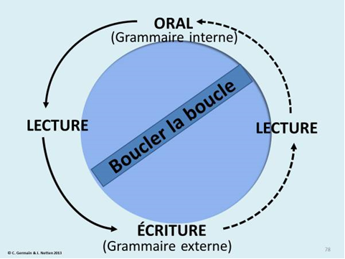
English Prime with Intensive French (Grades 6-12)
Post-Intensive French Grades 6−8
    2−3 blocks/classes per week of French
    Focuses on further development of oral, reading, and writing communication skills
Post-Intensive French Grades 9−10
    1 course per year
    Reading texts that include greater complexity
    Writing tasks are more complex
Post-Intensive French Grades 11−12
    Available for all students
    Both courses are available online
    May select additional courses in
    French (e.g., Writing 110, Law 120)
Notes:
Students who learn French as a second language through the English Prime program will continue until Grade 10. From Grades 6 through 8, 12% of the weekly instructional time is in French.
Students will have the opportunity to improve their language skills and aim for higher oral, reading and writing competencies. More complex learning will take place in Grades 9 and 10, where there is one course at each level.
Students enrolled in a French course in grade 12 are eligible for an oral proficiency interview through the province of NB.
The online courses for Post-Intensive French 110 and 120 allow for all students and schools to access quality French instruction. These courses have a strong oral component and are interactive in nature. In grades 11 and 12, English Prime students may choose to enroll in any course offered in French. There are online courses in French accessible from every high school – including, Coop Education, Intro to Environmental Science, Hospitality and Tourism, Law, Writing, and Techniques de communication orale.

Slide 14

French Immersion Overview
Language proficiency targets
Each program has its own language proficiency targets in the areas of oral proficiency, reading, and writing.
Program availability
Spring registration supports district planning.
Families are encouraged to register within the designated dates.
Depends on such factors as student enrollment (see Policy 309).
French Immersion and Inclusion
If French Immersion is available in your community, it is an option for all learners.
Notes:
Each FSL program has its own language targets describing how well learners will speak, read and write. Language learning is a lifelong pursuit. Students are provided with opportunities to use the language in various contexts. We will expand on this later in the presentation.
French Immersion program availability depends on student enrollment (and sustainability of the program).
If French Immersion is available in your community, it is an option for all learners.

Slide 15

Grade 1 French Immersion
Program is designed for early learners.
Emphasis on oral language in all subjects, followed by learning to read and write in French from the beginning of the program.
Language is modelled; teachers support students as they learn the new language at their own pace.
Based on the most current research.
Notes:
In the Grade 1 French Immersion program, children will learn language through a literacy-based approach. They will develop skills by exploring familiar topics of personal interest.
Teachers will model the language and support young learners as they acquire French through authentic language experiences. The interactive program uses music, poems, games and educational play.
Teachers might provide a model. For example, they might say: Je m’appelle Paul, comment t’appelles-tu ? while using gestures to help with understanding. Students will practice this together and then they would read about introducing themselves and then write an introduction of themselves.

Slide 16


Grade 1 French Immersion Overview
Subjects taught in French
Most subjects are taught in French (literacy, social studies, math and science).
Specialties (art, music, physical education, etc.) may be taught in French.
French instruction
Grades 1 and 2:
Grades 3 to 5:
Grades 6 to 8:
Grades 9 and 10:
Grades 11 and 12:
85-90%
80%
70%
50%
25%
Notes:
In the French Immersion program, most subjects are taught in French; this typically includes Literacy, Social Studies, Math, and Sciences.
Other subject areas are also included according to the number of hours needed to complete program requirements.
The percentage of French instruction depends on the grade level.
English Language Arts is taught in Kindergarten as well as grades 3 to 12.

Slide 17

Grade 1 French Immersion Program Overview
85-90% of instruction is in French in Grades 1 and 2.
80% of instruction is in French in Grades 3 to 5.
English Language Arts is introduced in Grade 3.
Curriculum has been updated to reflect the new entry point.
Notes:
In the Early French Immersion Program, 85% or more of the instructional day is in French in grades 1 and 2. In grades 3 to 5, 80% of the day is in French.
There is an integrated curriculum to introduce Science, Social Studies and Well-Being. There are resources appropriate for younger learners to support language development and learning in these areas.
English Language Arts is introduced in Grade 3. However, many of the skills acquired through French literacy are transferable and coordination between French and English Language Arts (beginning in grade 3) supports literacy development in both languages.

Slide 18


Grade 6 Late French Immersion
Literacy skills are developed through both French Immersion Language Arts and English Language Arts.
There is an emphasis on oral language in all subjects, followed by learning to read and write in French from the beginning of the program.
Language is modelled; teachers support students as they gradually learn new concepts in their second language.
70% of instruction is in French in grades 6-8
50% of instruction is in French in grades 9-10
25% of instruction is in French across grades 11-12
Notes:
The Late French Immersion program begins in Grade 6 if circumstances warrant.
Exposure to the French language at the elementary level enables students to transition smoothly to French Immersion in grade 6.
Teachers will model the language to support student success through French Immersion Language Arts as well as content areas such as math, science and social studies.
In FI Language Arts, the beginning of the year has a focus on building confidence in oral language, speaking and listening. Reading and writing instruction is gradually introduced. Teachers will build on previously acquired skills to support literacy instruction.
In content area classrooms, the teaching of vocabulary and oral language skills specific to the topics of study are used to learn. Reading and writing is modelled at the beginning to support language skills being acquired.

Slide 19
A Typical Day in French Immersion
Grades 1−2 (Exploration Time) | Grades 3−5 (Cross-Curricular Block) | Late Entry 6-8
 |  | Early Entry 6-8
Warm-up (French) | English Language Arts | English Language Arts
Message of the day: word work and sound work (French)
 | French Language Arts | French Language Arts
Oral (French) |  | Science (French)
RECESS | RECESS | RECESS
Oral (French) | Social Studies (French) | Social Studies (French)
Reading (French) | Health and Well-Being (French) | Health and Well-Being (French)
LUNCH | LUNCH | LUNCH
Writing (French) | Science (French) | Science (French)
Math (French) | Math (French) | Math (French)
Physical Education, Music, Art (English) | Physical Education, Music, Art (English) | Physical Education, Music, Art (English)
Notes:
This slide shows what a typical day in French Immersion might look like next year. In powder blue, you will see the subjects taught in French. Phys Ed, Music, and Art may be taught in English or French.
*The middle school day would be similar for early and late immersion learners.

Slide 20

French Immersion in High School
Grades 9 & 10 – 50% of instructional time is conducted in French
In addition to French Immersion Language Arts, courses may include math, science, social studies, history, physical education
Grades 11 & 12 – 25% of instructional time conducted in French
Courses may include chemistry, physics, math Techniques de communication, French Immersion Language Arts, History, World Issues, Biology, etc.
Notes:
In Grades 9 and 10, students are expected to complete 50% of their courses in French.
In Grades 11 and 12, students are expected to complete 25% of the courses in French.
Students are encouraged to exceed these minimum requirements where circumstances allow.

Slide 21

Advantages of Learning to Speak French
Completing French Immersion throughout high school:
    Advantages…
    Increased confidence and sense of achievement
    May provide additional educational and career opportunities
    Language learning has benefits for brain development
    Opportunities communicate in French while travelling and to experience other cultures
    Helps students gain an understanding of and appreciation for other cultures
    Enjoyable
    Enables students to distinguish themselves from their peers in other jurisdictions
Start early and stay for as long as possible to maximize skillset!
Notes:
The study of French offers many advantages to learners. These include:
Increased confidence and sense of achievement
Improved prospects for education and career
Heightened brain development
Opportunities to travel and experience other cultures
Amplified empathy and thoughtfulness
Moreover, learning a second language is enjoyable and enables students to distinguish themselves from their peers.

Slide 22

French Choices for students in High School
The following online courses are available in French:
    Law
    Environmental Science
    Writing
    Hospitality and Tourism
    Techniques de communication
    Co-op and Virtual Co-op Education
    Options for Credit:
      UdeM, Université Sainte-Anne, Les Jeunes chanteurs d’Acadie,
      YMCA Summer Work Exchange Program, and personal interest
      opportunities
These options are open to Post-Intensive
French students in grades 11 and 12.
Notes:
The following online courses are currently available in French: Law, Environmental Science, Writing, Hospitality and Tourism, Techniques de Communication, Co-op and Virtual Co-op. There are also exciting opportunities in the form of Options for Credit available to students.

Slide 23
Learning to Read in Grades 1 and 2
Language skills are transferable:
Phonological awareness
Syntax
Decoding strategies
Comprehension strategies
Self-correction and general awareness of language
Awareness of personal thought processes
Learning a second language:
Provides insight into using home language
Broadens understanding of culture
Enables learners to be more appreciative of other perspectives
English Prime
Reading instruction is in English
French Immersion
Reading instruction is in
French
Notes:
Learning to speak French enables students to become more proficient in English by fostering transferable language skills such as phonological awareness, syntax, decoding strategies, comprehension strategies, self-correction and general awareness of language, as well as awareness of personal thought processes.
Learning a second language also promotes individual growth by providing insight into first language, broadening understanding of culture, and enabling learners to be more appreciative of other perspectives.

Slide 24

The Role of Families/Family Support
Attitude and motivation contribute to success in learning a new language.
The level of French that students attain by high school graduation will vary from one student to another, in the same way as performance varies in other subject areas.
Your enthusiasm and encouragement will help your child to get the most from their program of choice.
French materials may be accessed through:
Electronic Library New Brunswick (ELNB)
French Language Learning @ GNB
Notes:
Regardless of the program, activities such as reading for pleasure or watching a show in French will help students develop their second language skills. Services such as Netflix and YouTube provide easier access to French materials which will appeal to students’ interests. Families are also encouraged to access materials from Electronic Library New Brunswick (ELNB) (“virtual branch” of New Brunswick Public Libraries) as well as French materials on the Education and Early Childhood Development (EECD) website.

Slide 25
Cultural and Language Learning Opportunities to Support Students
(Grades 6-12) in Reaching a Conversational Level
Summer French Program for Students in Grades 9 and 10: 4-week program at Université de Moncton Summer French High School 2022
Virtual New Brunswick−Quebec Exchange Program: possibilities are being explored Virtual NB-Quebec Exchange 2022
Explore (ages 16+): 5-week summer French program in locations across Canada. (https://englishfrench.ca/)
Explore Youth Initiative (ages 13−15): 3-week summer French program. (https://englishfrench.ca/)
Virtual Summer French Program for Middle School Students (Grades 6, 7 and 8) Virtual Summer French Middle School 2022
For up-to-date information, please visit
French Second Language Opportunities for Students
Notes:
It is recommended that learners plan to participate in other exciting opportunities offered through government programs. These will maximize French language development. Doing a bilingual exchange or participating in summer programs can dramatically improve a student’s confidence and ability in French.
For more information about summer and exchange programs for Grade 6 – 12 students, please visit www.gnb.ca/fsl

Slide 26


Innovation
IMPROVEMENTS ARE ONGOING IN ALL AREAS OF EDUCATION
Education plays a key role in developing and promoting bilingualism in New Brunswick. Current French Second Language Program innovations include:
FLORA blended learning model introduced in 2017 – currently in use in the majority of provinces and territories as well as internationally. Being used by more than 50 elementary schools in NB
Language Learning Opportunities (LLO) prototypes started in 2021 in 2 early learning centres and 11 schools. The focus is on improving conversational French (B1.1) by applying best practices and local decision-making Language Learning Opportunities (gnb.ca)
Your local school may already be involved or may become involved in improvement initiatives in the future.
Notes:
Innovation – Improvements are ongoing in all areas of education
New Brunswick is at the forefront of French language programing. Numerous innovations have been introduced such as Intensive French, FLORA, and Language Learning Opportunities where communities adopt best practices based on their unique circumstances.

Slide 27



Innovation – Language Learning Opportunities (LLO)
What do I need to know for 2022-2023 school year if my school is participating in Language Learning Opportunities Prototypes?
French Second Language learning will continue, grow, and be supported at your school if your school is participating in the Language Learning Opportunities prototype initiative.
What are the benefits of LLO?
Collaboratively, school personnel and the learning community create a French Second Language program based on best practice and the specific needs of their learners in a local context.
How do I get more information about my school’s
prototype plans?
If your school is participating in the LLO prototype initiative, you
will receive additional information from your administration.
Notes:
What do I need to know if my school is participating in the LLO initiative?
French Second Language learning will continue, grow, and be supported at your school.
What are the benefits of LLO?
Schools and their learning community work collaboratively to create a French Second Language program based on best practice and the specific needs of their learners within their context.
How do I get more information about my school’s prototype plans?
Please contact your school directly.

Slide 28

For more information, visit:
Everyone at their best:
Learning French as a Second Language
Everyone at their best!
Notes:
Thank you for your interest in New Brunswick’s French second language programs. If you have additional questions about current programs, please contact your local school district.

